Slide 1
Early Detection of Configuration Errors to Reduce Failure Damage
Tianyin Xu, Xinxin Jin, Peng Huang, and Yuanyuan Zhou, University of California, San Diego; Shan Lu, University of Chicago; Long Jin, University of California, San Diego; Shankar Pasupathy, NetApp, Inc.
OSDI 2016
Presented by Chuhong Yuan
May 31, 2019

Slide 2
Abstract
Configuration errors
Latent until executed
Severe consequences
No or incomplete configuration check
PCHECK
Detect early in initialization phase
Emulate the late execution

Slide 3
Outline
Motivation
Survey
Design & Implementation
Evaluation
Limitation & Conclusion

Slide 4
Outline
Motivation
Survey
Design & Implementation
Evaluation
Limitation & Conclusion

Slide 5
Configuration errors
Hard to handle
Existing mechanism is not effective, e.g. redundancy
Configuration of fault handling
Severe damage
Spread through the cluster
Latent
Administrators do not perform extensive testing
Skip the checking
Check configurations right before using
Errors undetected until manifestation

Slide 6
Latent configuration (LC) errors
Severity Level | Latent | Non-latent
All cases | 47.6% | 52.4%
High severity | 75.0% | 25.0%
Error class | Mean | Median
Latent | 1.14 | 1.70
Non-latent | 0.87 | 0.41
Diagnose time (normalized)

Slide 7
Related works
Identify the root cause
Cannot prevent failures
Check with constraints
Manually specify every single constraint
Learn “normal” values
Require large collection of independent configuration
Not suitable for inherently different configurations
Specific error types
conf_spellchecker
Type inference

Slide 8
Solution
Detect as early as possible
Context-sensitive
Emulate the late execution
Generic rather than specific
PCHECK

Slide 9
Outline
Motivation
Survey
Design & Implementation
Evaluation
Limitation & Conclusion

Slide 10
Methodology
RAS-related features
Reliability, Availability, Serviceability
Study the check and use
Check in initialization phase
Compare the check and use
Verify
Expose and observe the impact

Slide 11
Findings
Software | Deficiency of initial checking |  | Studied param.
 | Missing | Incomplete
HDFS | 41 (92.3%) | 3 (6.9%) | 44
YARN | 29 (82.9%) | 5 (14.3%) | 35
HBase | 18 (72.0%) | 5 (2.0%) | 25
Apache | 4 (28.6%) | 2 (14.3%) | 14
Squid | 9 (42.9%) | 4 (19.0%) | 21
MySQL | 6 (14.0%) | 6 (14.0%) | 43

Slide 12
Findings
Software | Not used during initialization | Studied param.
HDFS | 17 (38.6%) | 44
YARN | 9 (25.7%) | 35
HBase | 3 (12.0%) | 25
Apache | 4 (28.6%) | 14
Squid | 4 (19.0%) | 21
MySQL | 6 (13.9%) | 43

Slide 13
Findings
Software | Subject to LC errors | Studied
HDFS | 17 (38.6%) | 44
YARN | 9 (25.7%) | 35
HBase | 3 (12.0%) | 25
Apache | 3 (21.4%) | 14
Squid | 3 (14.3%) | 21
MySQL | 2 (4.7%) | 43
Total | 37 (20.3%) | 182

Slide 14
Implication
Deficiency of configuration checking at initialization
Usage of configuration can be implicit check
Usage-implied checking is rarely leveraged

Slide 15
Outline
Motivation
Survey
Design & Implementation
Evaluation
Limitation & Conclusion

Slide 16
PCHECK
Enable early detection of configuration errors
Automatically generate checkers
Generic rather than specific
Based on Soot and LLVM
Intermediate representation (IR)

Slide 17
Challenges
Automatically emulate the execution
Avoid side-effects on the internal/external states
Capture anomalies

Slide 18
Challenges
Automatically emulate the execution
Static taint analysis
Avoid side-effects on the internal/external states
“Sandbox”, global vars – local vars
Rewrite APIs
Capture anomalies
System and language error identifiers

Slide 19
Outline
Motivation
Survey
Design & Implementation
Emulating execution
Preventing side effects
Capturing anomalies
Invoking early checkers
Evaluation
Limitation & Conclusion

Slide 20
Outline
Motivation
Survey
Design & Implementation
Emulating execution
Preventing side effects
Capturing anomalies
Invoking early checkers
Evaluation
Limitation & Conclusion

Slide 21
Emulating execution
Identifying starting points
Developers specify the interface
Regular expression
Extracting instructions using configuration
Data-flow analysis
Producing execution context
Backtracking data-flow analysis
Encapsulation
Generate checkers

Slide 22
Extracting instructions using configuration
mode = getInt(“mode”)
c = (char) mode
mode = mode & 0x001
f(c)
g(mode)

Slide 23
Extracting instructions using configuration
Transformation
mode = getInt(“mode”)
c = (char) mode
mode = mode & 0x001
f(c)
g(mode)
Usage

Slide 24
Extracting instructions using configuration
mode = getInt(“mode”)
c = (char) mode
mode = mode & 0x001
if (mode != 5)
f(c)
g(mode)

Slide 25
Extracting instructions using configuration
mode = getInt(“mode”)
c = (char) mode
mode = mode & 0x001
if (mode != 5)
f(c)
g(mode)

Slide 26
Extracting instructions using configuration
mode = getInt(“mode”)
c = (char) mode
mode = mode & 0x001
if (mode != 5)
mode != 5
f(c)
g(mode)
h(mode)
open(mode)

Slide 27
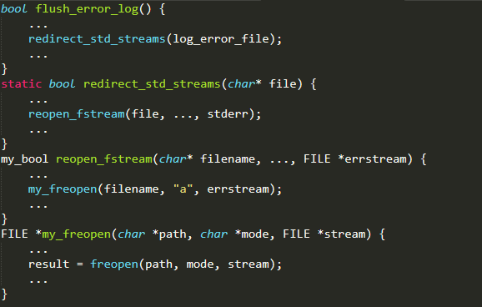
Producing execution context

Slide 28
Producing execution context

Slide 29
Producing execution context

Slide 30
Producing execution context

Slide 31
Producing execution context
Unneeded for it will be rewritten

Slide 32
Producing execution context
Dependent variables
Indeterminate global variables
External inputs (from I/O or network)
Remove the instructions with dependent variables

Slide 33
Encapsulation
Checker function
Configuration-consuming instructions
Context
Create new variables
Inline the callees
Multiple execution paths
Multiple checkers
No path explosion
Merge checkers
Equivalent or subset
Reuse transformation

Slide 34
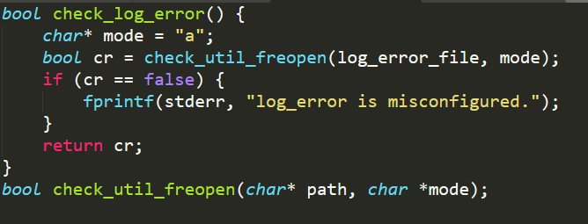
Encapsulation

Slide 35
Outline
Motivation
Survey
Design & Implementation
Emulating execution
Preventing side effects
Capturing anomalies
Invoking early checkers
Evaluation
Limitation & Conclusion

Slide 36
Preventing side effects
Not change internal or external effects
Copy global variables to local variables
Rewrite standard APIs
System calls, libc, Java core packages
Skip read/write & send/recv
Metadata checks, reachability checks
Safe and efficient
Remove not defined calls
Sandbox or VM? Difficult to use

Slide 37
Capturing anomalies
Runtime exceptions
Java, try/catch
Error code
C, predefined
Abnormal termination and error logging
Post-dominated instructions
Insert error-reporting instructions
Abandon others

Slide 38
Invoking early checkers
End of the initialization
Annotated by users
After user/group identities change
TOCTTOU (Time-Of-Check-To-Time-Of-Use)
Run periodically
Remove redundant checking
Instructions executed before checkers invoked
Standalone checking programs
Run when configuration files changed
No internal side effect
Has to include parse/store configuration procedure

Slide 39
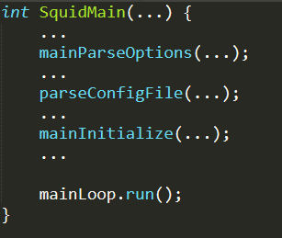
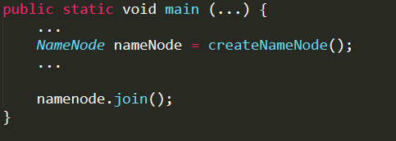
Invoking early checkers
Invoke checkers
Invoke checkers

Slide 40
Outline
Motivation
Survey
Design & Implementation
Evaluation
Limitation & Conclusion

Slide 41
Methodology
58 LC error cases
21 historical, 37 new
830 configuration files
All types
Compare with conf_spellchecker

Slide 42
Detecting real-world LC errors
Type of LC errors | # (%) LC errors detected
 | Historical | New
Type and format error | 1/1 (100.0%) | 13/13 (100.0%)
Undefined option/range | 2/2 (100.0%) | 4/4 (100.0%)
Incorrect file/dir path | 9/12 (75.0%) | 5/7 (71.4%)
Other erroneous setting | 3/6 (50.0%) | 7/13 (53.8%)
Total | 15/21 (71.4%) | 29/37 (78.4%)
conf_speakchecker detects 7/21 (33.3%) and 11/37 (29.7%)

Slide 43
Checking real-world configuration files
Software | # config files | # (%) detected config. errors
 |  | All | Env. specific
HDFS | 245 | 40 | 15 (37.5%)
YARN | 81 | 49 | 32 (65.3%)
HBase | 405 | 139 | 95 (68.3%)
Apache | 65 | 41 | 36 (87.8%)
MySQL | 34 | 13 | 10 (76.9%)

Slide 44
Checker generation
Software | # checked param. (# checkers) | All params
HDFS | 164 (252) | 164
YARN | 116 (200) | 116
HBase | 125 (201) | 125
Apache | 18 (41) | 97
Squid | 45 (74) | 216
MySQL | 32 (51) | 462
Checked params of the later 3 are so few?
Used in parse phase
Used for condition
Used in initialization
Use indeterminate values or not rewritten APIs

Slide 45
Checking overhead
4-core, 2.50GHz processor connected to a local network
Software | Time for running the checkers (millsec.)
HDFS | [NameNode] | 408 | [DataNode] | 311
YARN | [ResourceMgr] | 243 | [NodeMgr] | 486
HBase | [HMaster] | 780 | [RegionServer] | 777
Apache | [httpd] | 0.6
Squid | [squid] | 93.8
MySQL | [mysqld] | 1.7

Slide 46
False positive
Only 3 false positives
2 from YRAN, 1 from HBase
Skip conditional instructions affected by the configuration value
Low false positive rate
1.7% for YARN
Can be removed by developer

Slide 47
Outline
Motivation
Survey
Design & Implementation
Evaluation
Limitation & Conclusion

Slide 48
Limitation
Neither sound nor complete
Instruction-level anomalies
Valid values, but unintended system behavior
Resource constraints or performance requirements
Execution depends on runtime inputs/workloads
Trade soundness for safety and efficiency

Slide 49
Conclusion
Latent configuration errors
Early detection
PCHECK
No datasets requirement
Generic
Emulate usage context

Slide 50

Thank you!
Q & A

